Slide 1
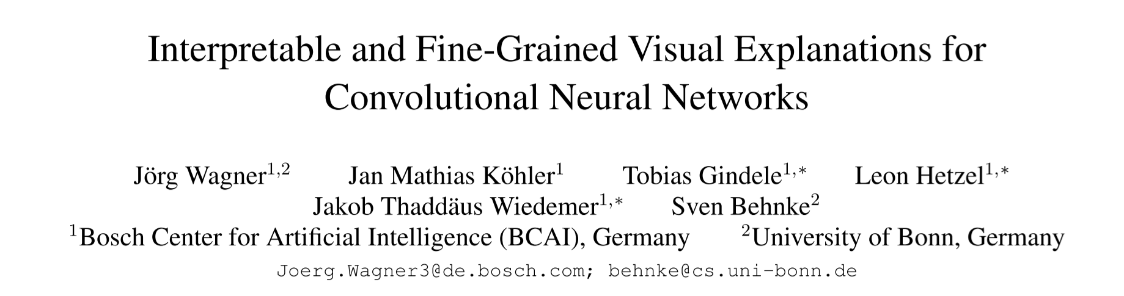
Notes:
卷积神经网络的细粒度的可视化解释

Slide 2
Abstract
Our approach is based on a novel technique to defend against adversarial evidence (i.e. faulty evidence due to artefacts) by filtering gradients during optimization.
Fine-grained and preserve the characteristics of images
We qualitatively and quantitatively evaluate our approach on a multitude of models and dataset
Notes:
我们的方法是基于一种新的技术，在优化过程中通过过滤梯度来抵御对抗性证据(即人工引入的缺陷证据)。
细粒度和保持图像的特征

Slide 3
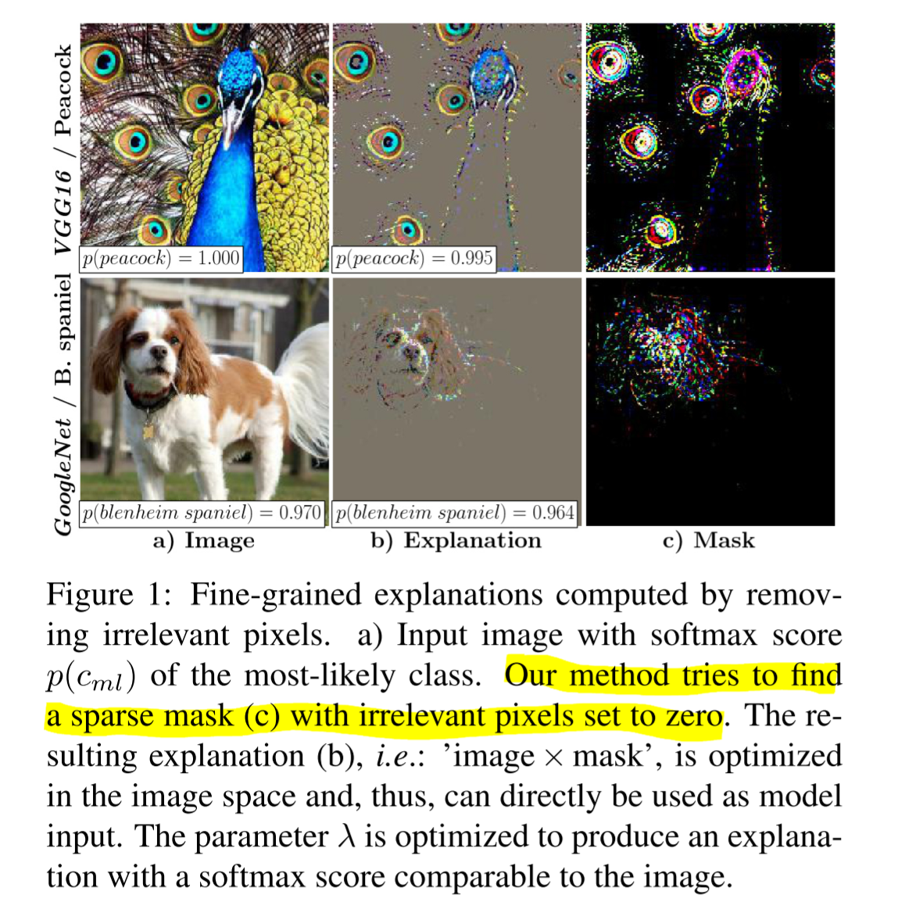

Slide 4
Introduction
定义了什么是好的解释：
An explanation should be easily interpretable
Explanations should be faithful, meaning they accurately explain the function of the black-box model
本文解决：改良基于优化的可视化解释模型：
A major concern of optimization based visual explanation methods is adversarial evidence
New adversarial defense technique which selectively filters gradients in the optimization which would lead to adversarial evidence otherwise
Notes:
容易理解
faulty evidence generated by artefacts introduced in the computation of the explanation
人工计算解释时引入的错误迹象
Therefore, additional constraints or regularizations are used to prevent such faulty evidence. A drawback of these defenses are added hyperparameters and the necessity of either a reduced resolution of the explanation or a smoothed explanation , thus, they are not well suited for displaying fine-grained evidence.
额外的限制规则；缺点 增加了超参数 并且需要降低解释的分辨率或平滑处理的解释，因此，它们不适合显示细粒度的解释。
过滤掉导致对抗证据的的梯度
这是第一种能够在图像空间中直接产生细粒度解释的方法

Slide 5
Related Work（亮点）
Backpropagation Based Methods (BBM)： These methods generate an importance measure for each pixel by back-propagating an error signal to the image.
Activation Based Methods (ABM)： These approaches use a linear combination of activations from convolutional layers to form an explanation.
Perturbation Based Methods (PBM)： Such approaches perturb the input and monitor the prediction of the model.
Notes:
这些方法通过将错误信号反向传播到图像中，为每个像素生成一个重要度量。
这些方法使用来自卷积层的激活的线性组合来形成一个解释。
这种方法会干扰输入，并监控模型的预测。 （本文属于此类）

Slide 6
Perturbation based Visual Explanations
Compute a perturbed version of the image：
Explanation by Preservation: The smallest region of the image which must be retained to preserve the original model output (i.e. minimal sufficient evidence).
Explanation by Deletion: The smallest region of the image which must be deleted to change the model output.
Notes:
回顾 两种
不改变模型输出 保存的最小区域
改变模型输出 删除的最小区域

Slide 7
Perturbation based Visual Explanations
Explanation e of target class c is computed by removing either relevant (deletion) or irrelevant, not supporting c, information (preservation) from the image.
Use an approximate removal operator -- Mask based operator Φ, which computes a weighted average between the image x and a reference image r
Notes:
通过从图像中删除相关(删除)或不相关(不支持c)信息(保存)来计算目标c类的解释e。
mct mask

Slide 8
Perturbation based Visual Explanations
Common choices for the reference image are constant values (e.g. zero), a blurred version of the original image, Gaussian noise, or sampled references of a generative mode
We take a zero image as reference
Notes:
参考图像的常见选择是常数值(如零)、原始图像的模糊版本、高斯噪声或 生成
在我们看来，这个参考产生了最令人愉快的视觉解释，因为不相关的图像区域被设置为零（解释一下），没有被其他结构代替。此外，零图像(和随机图像)携带的信息相对较少，导致模型高熵预测。模式已采样引用

Slide 9
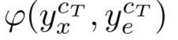
Perturbation based Visual Explanations
A similarity metric is needed which measures the consistency of the model output generated by the explanation E and the output of the image X with respect to a target class C.
Typical choices for the metric are the cross-entropy with the class cT as a hard target or the negative softmax score of the target class cT
Notes:
测量由解释E生成的模型输出与图像X的输出相对于目标类C的一致性。
解释忠实于模型，从而准确地解释了模型的功能
如果解释保留了目标类的输出，那么这个相似度度量应该是小的;如果解释能够显著降低目标类的概率，那么这个相似度度量应该是大的
该指标的典型选择是将cT类作为硬目标的交叉熵或目标cT类的负软最大值

Slide 10
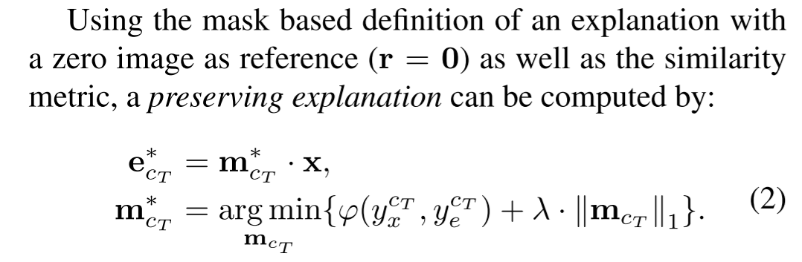
Perturbation based Visual Explanations
Notes:
preservation

Slide 11
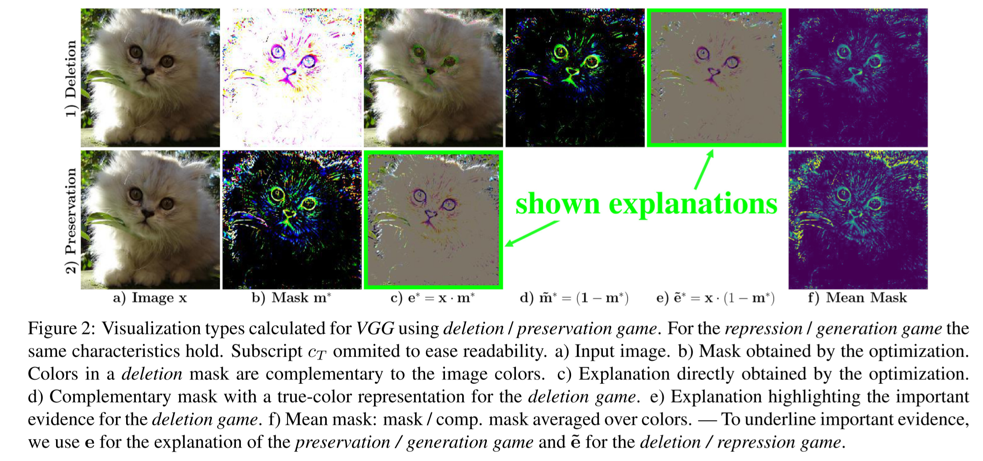
Perturbation based Visual Explanations
Notes:
Eq2 是 preservation 规则 b2 mask非常稀疏 保留了高价值的最重要的像素 叠加到原图上产生的解释 c2

Slide 12
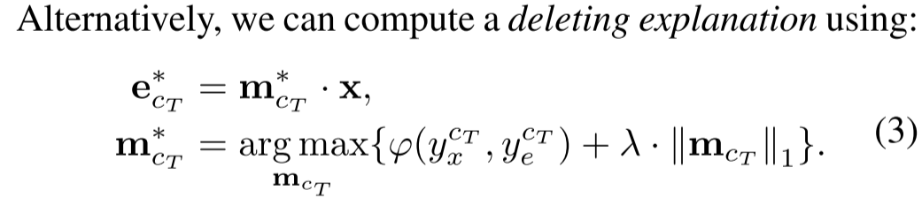
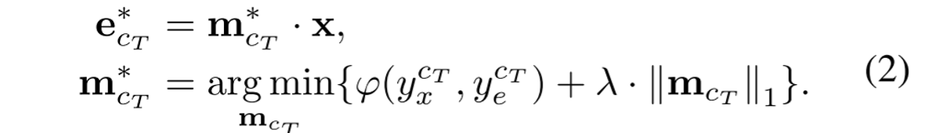
Perturbation based Visual Explanations
Notes:
看看图 与原图颜色互补

Slide 13
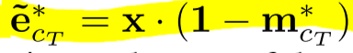
Perturbation based Visual Explanations
提出的修改:
Notes:
为了更好的可视化，在剩下的文章中，我们描述了一个修改版本的删除规则的解释
与保存相比，删除通常产生较少的解释，因为删除一个类的证据所需要删除的像素比通过保存像素来维护证据所需要删除的像素要少。

Slide 14
Defending against Adversarial Evidence
adversarial noise对优化模型的影响很大
一般来说，这些操作通过模糊模型易受错误证据影响的梯度方向，或者通过限制潜在对手的搜索空间来阻止对抗性噪声的产生
Notes:
增加了超参数 并且需要降低解释的分辨率或平滑处理的解释 其中一种方法

Slide 15
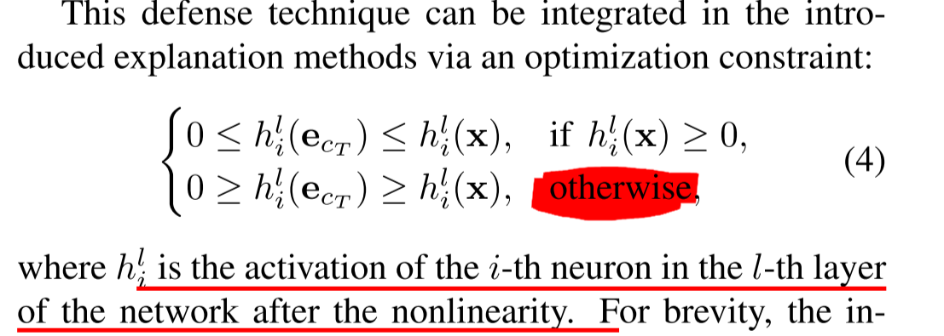
Defending against Adversarial Evidence
A neuron within a CNN is only allowed to be activated by the explanation E if the same neuron was also activated by the original image X
Notes:
只有当原始图像X也激活了同一个神经元时，CNN中的神经元才能被解释E激活

Slide 16
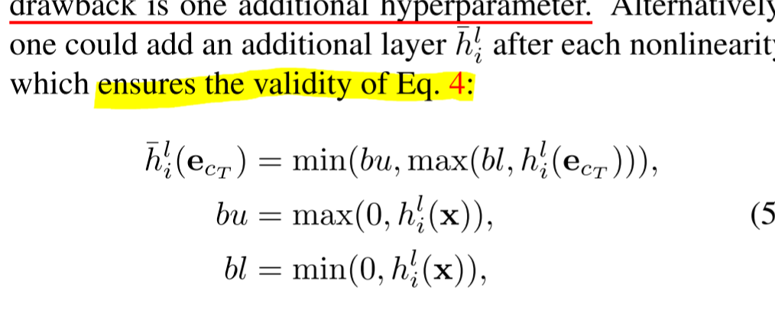
Defending against Adversarial Evidence
Notes:
不采用，改变了前向传播时模型结构

Slide 17
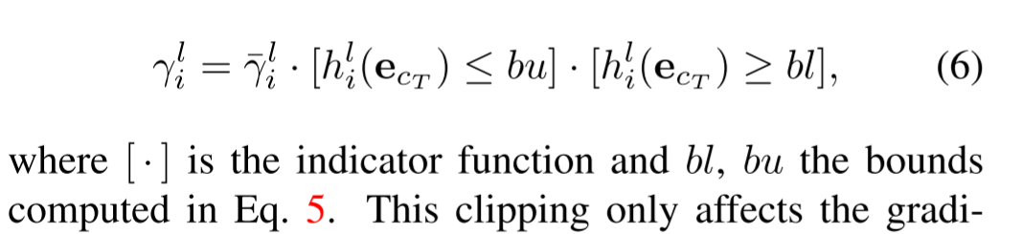
Defending against Adversarial Evidence
Notes:
我们在优化的反向传播通道中剪切梯度，这会导致违反公式4（不等式）。等价在每一个非线性层之后增加一个额外的剪切层
剪切层在前向传播中作为标识，在反向传播中使用Eq. 5的梯度更新。
反向传播时，一个错误信号通过剪切层时，针对错误信号的梯度更新规则为
点 是指示函数
提出的梯度裁剪方法不增加超参数，在前向遍历时保持模型的原始结构
这就是 Defense

Slide 18
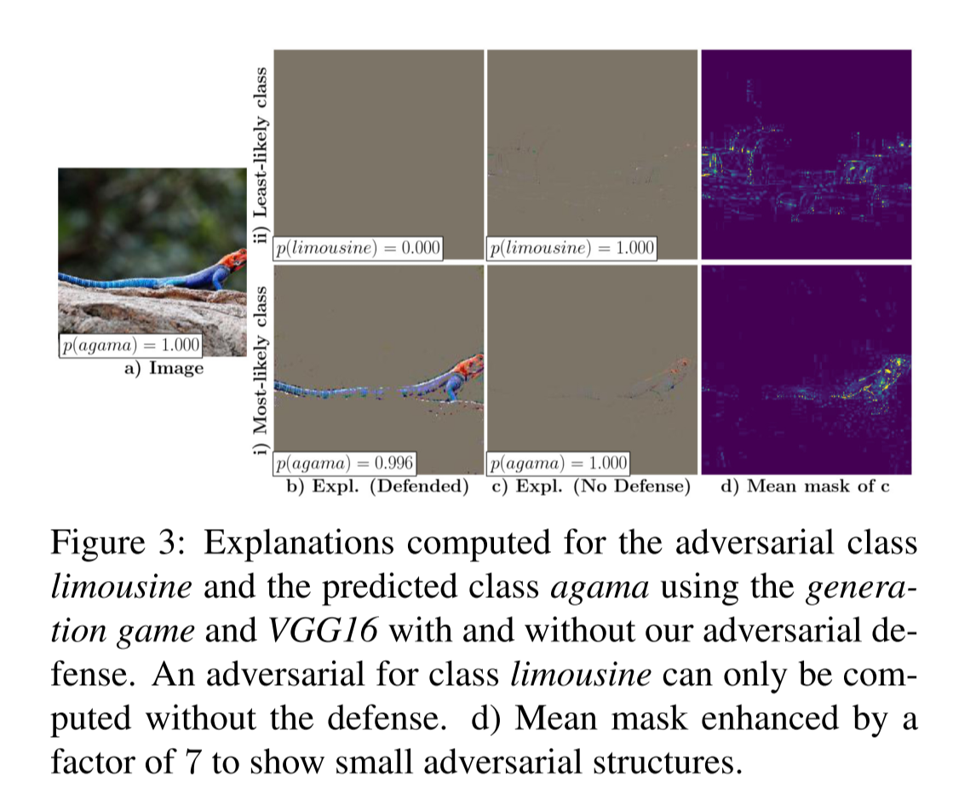
Defending against Adversarial Evidence
模仿对抗攻击
Notes:
由此产生的不带防御的解释类似于对抗性攻击
用鹦鹉来预测豪华车
如果解释方法易受对抗性噪声影响，则优化过程应能完美生成任何类的解释

Slide 19
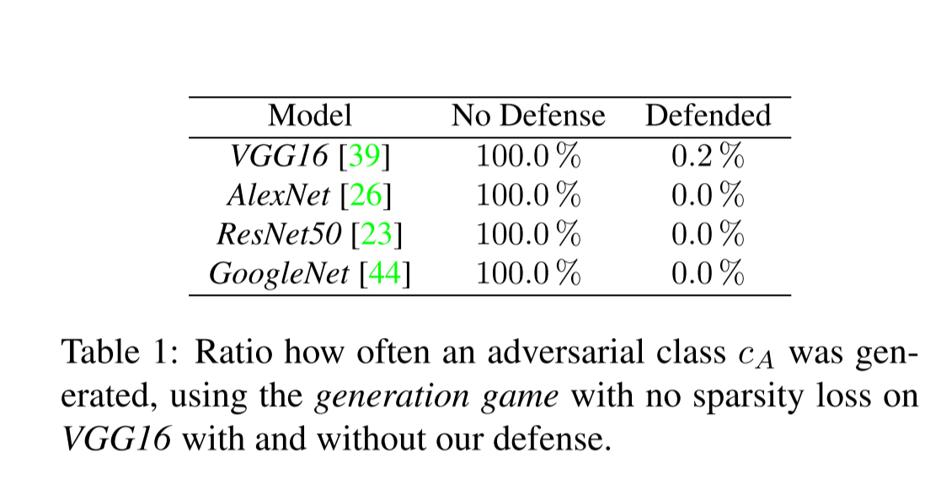
Defending against Adversarial Evidence
Notes:
不同的网络上跑实验 没有防御的都生成了解释
为了简化对抗性样本的生成，我们将稀疏性损失设置为零，并且只使用相似度度量来最大化目标类cA的概率

Slide 20
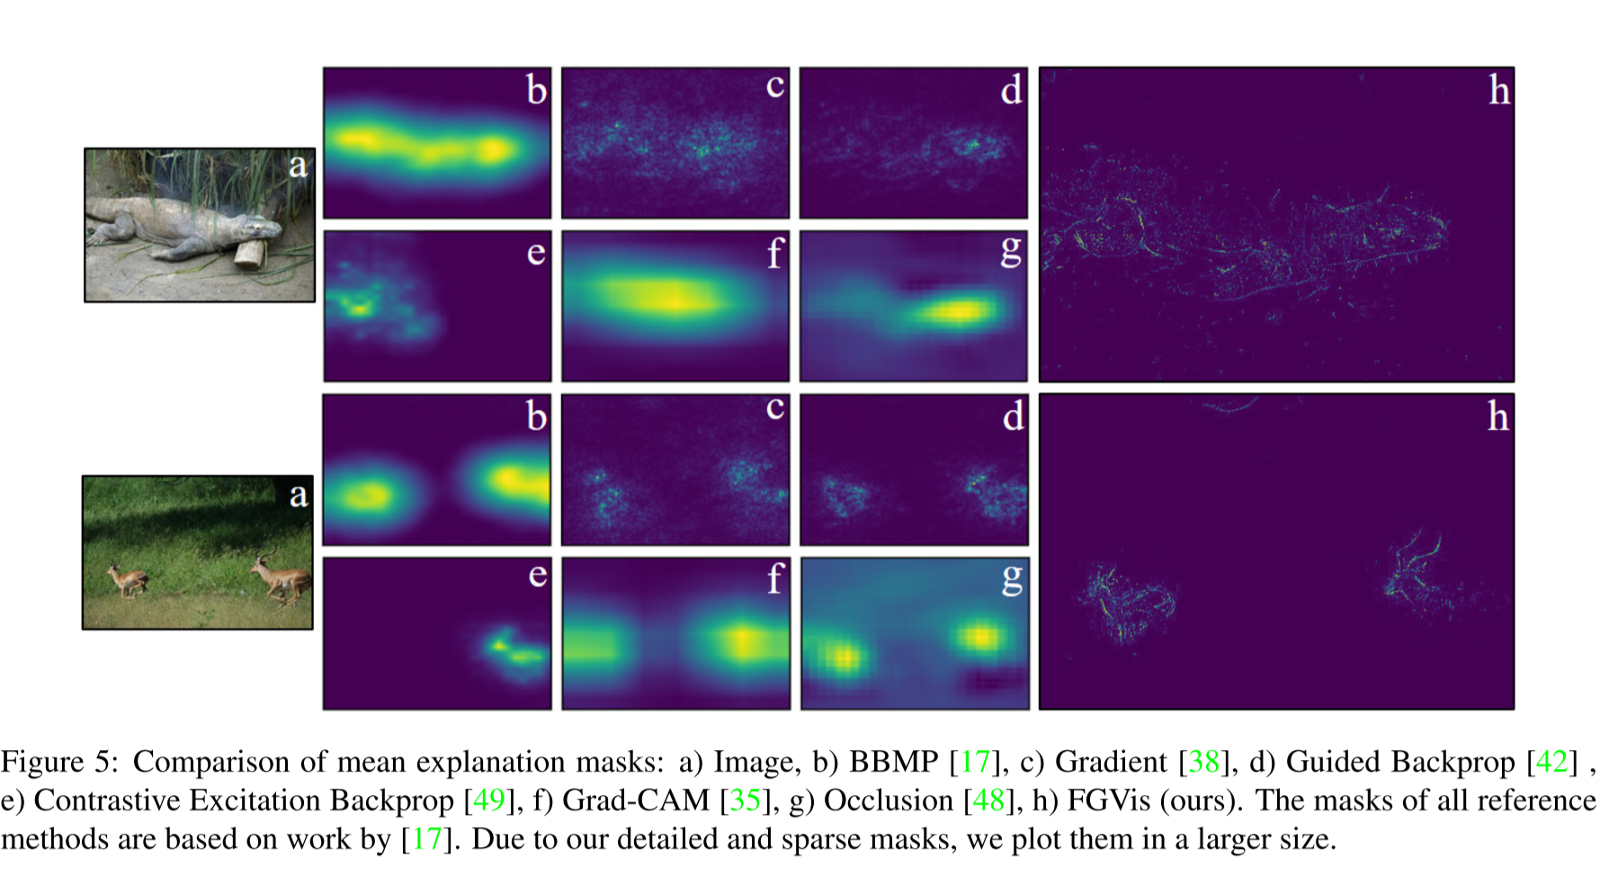
Qualitative Results
Notes:
产生最好的细粒度解释
Using the deletion game we compute mean explanation masks for GoogleNet and com-
pare these in Fig. 5 with state-of-the-art methods.

Slide 21
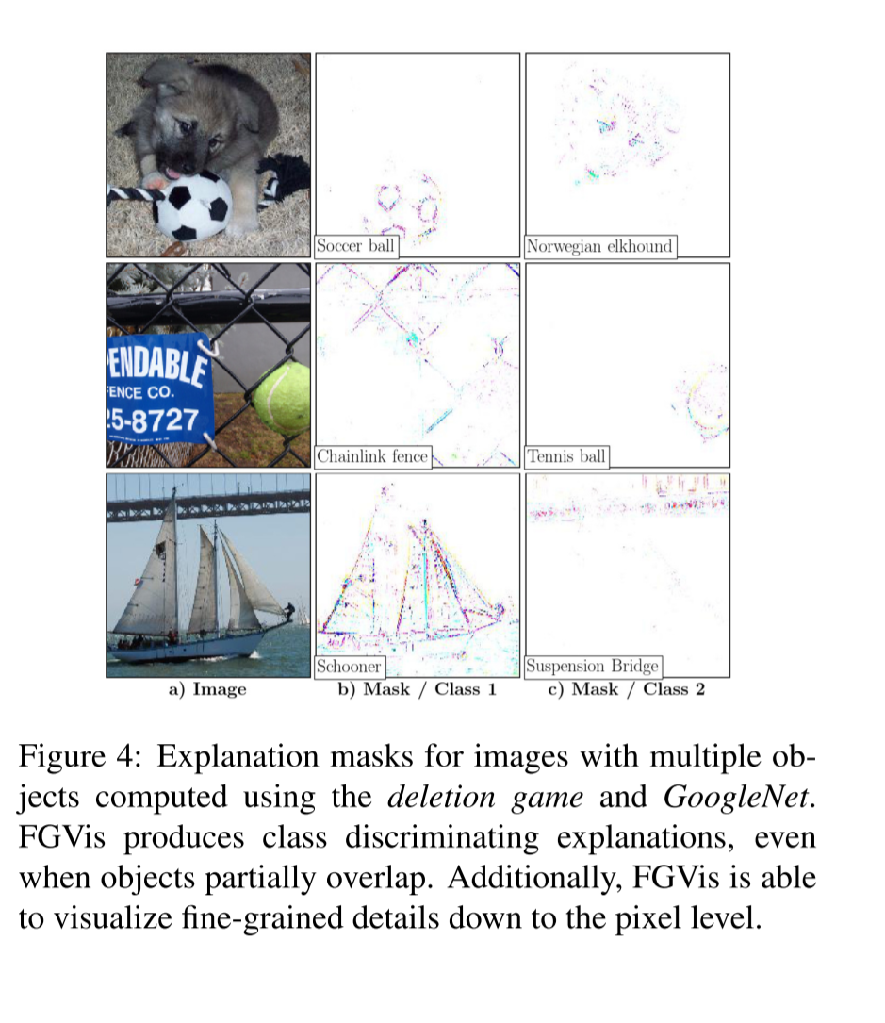
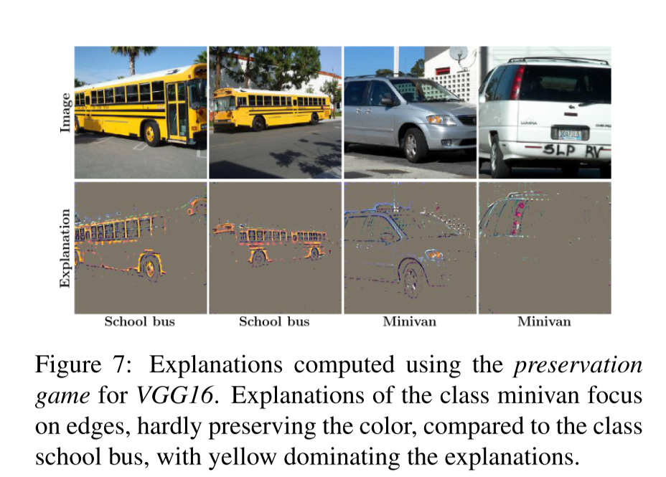
Qualitative Results
类识别
颜色通道的重要性

Slide 22
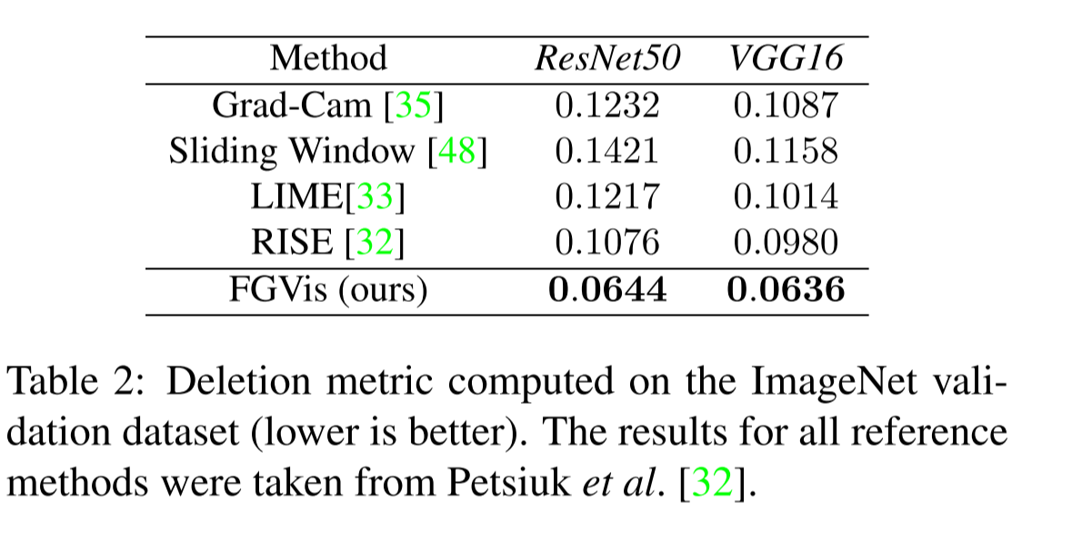
Quantitative Results
Notes:
使用不同的模型对ImageNet进行验证分割

Slide 23
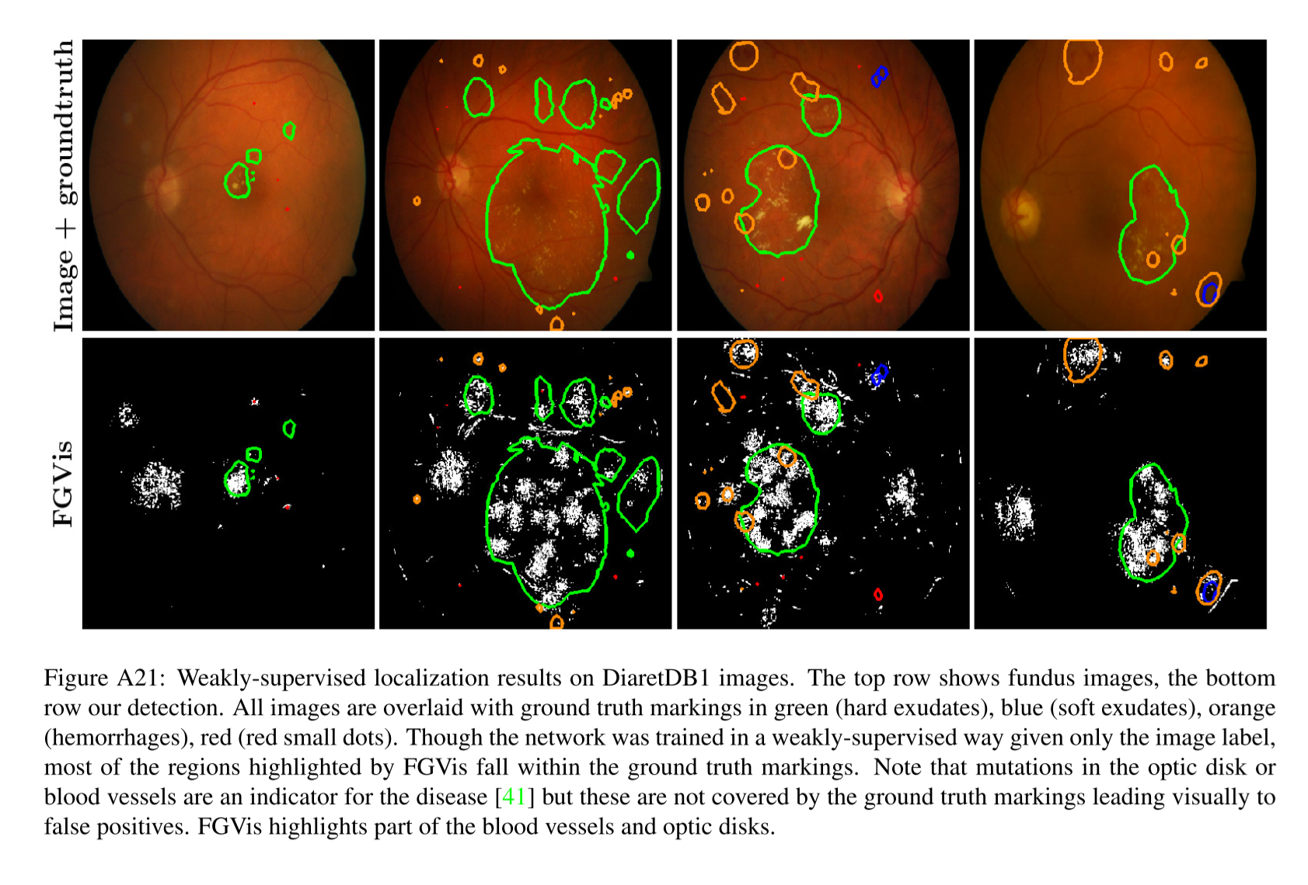
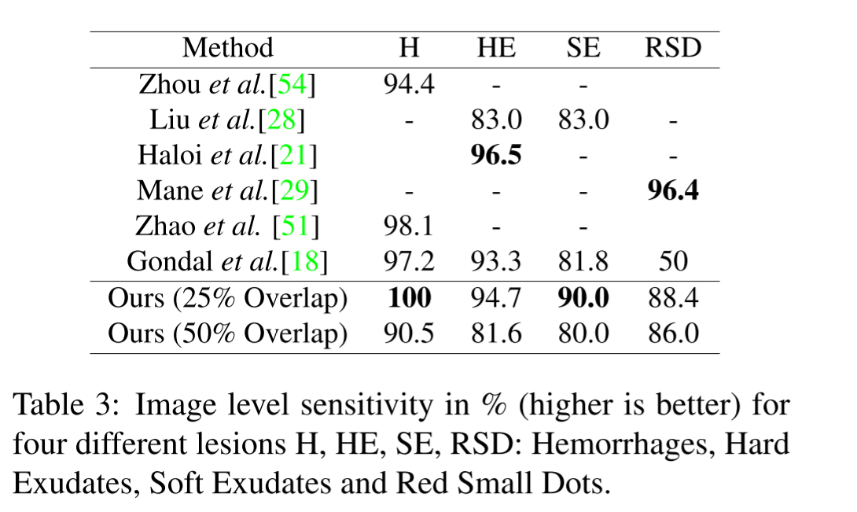
Quantitative Results
medical images

